Slide 1

The Evolving Role of the Chief Data Officer (CDO)
An investigation into findings gathered from the paper written by Seth Earley and published in the IT Professional Journal
Niamh Daly | x19370553@student.ncirl.ie
Notes:
Introduction:
In this presentation I will be talking about the paper ‘The Evolving Role of the Chief Data Officer’ that was written by Seth Earley and published in the ‘IT Professional’ for the January/February issue of 2017.
The ‘IT Professional’ is a bi-monthly peer-reviewed magazine published by the IEEE Computer society for the developers and managers of enterprise information systems. Some of the areas addressed in this magazine include emerging technologies, Web services, internet security, data management, enterprise architectures and infrastructures, etc,. https://en.wikipedia.org/wiki/IT_Professional_(journal)
I was able to use both the paper that was written for publication and the ‘Earley Executive Roundtable’ that was recorded on the ‘Evolving Role of the Chief Data Officer’ in February of 2017. https://www.youtube.com/watch?v=xRyfBQ3d2pU&ab_channel=EarleyInformationScience
Relevance to the course so far:
In week 2 of the module, we learned about the role of the Chief data officer and the importance of the assigning roles and responsibilities in the Data governance framework in order to have accountability for data. We have established that the Chief Data Officer is a role that is situated at the top of the Data Governance leadership hierarchy (in the executive level). We have learned that not all organisations have a CDO but industry analysis suggests the increasing interest in the role, which will be detailed in the slides to follow:
Last week in Daraghs presentation we also saw mention of the CDO and the increasing popularity of the role within companies for managing data

Slide 2
High Level Introduction to the Paper
To achieve digital transformation, organizations must gain control of the avalanche of data that is generated by supplier, customer, and employee interactions.
This complex data environment has led enterprises to realize that new leadership is needed to take on responsibility for data and information value.
The chief data officer (CDO) role has arisen to fill this need.
Seth Earley examines this relatively new role and its various forms.
Notes:
I am going to begin with a high level introduction into what was discussed within the paper.
The paper touched on the importance of gaining control of the avalanche of data that is generated by supplier, customer, and employee interactions in order to achieve digital transformations within businesses
The complex data environment that has emerged from the digital transformations has led enterprises to realize that new leadership is needed to take on responsibility for data and information value. And the paper addresses problems that occur in the absence of a CDO and the benefits of having a CDO within an organization
The chief data officer (CDO) role has arisen to fill the need within organizations
The paper was written in 2017, and Seth Earley examines this relatively new role and its various forms up until the time of writing

Slide 3


Seth Earley
An expert with 20+ years experience
CEO of Earley Information Science (EIS)
Worked with a diverse roster of Fortune 1000 companies
Author of “The AI-Powered Enterprise”
Recognized by Thinkers 360 as one of the Top 50 Global Thought Leaders and Influencers on Artificial Intelligence
Wrote a regular column on data analytics and information access issues and trends
Notes:
Who is Seth Earley:
First and foremost Seth Earley is the author of the paper as I have mentioned previously
He is an expert with 20+ years’ experience in Knowledge Strategy, Data and Information Architecture, Search-based applications and Information Findability solutions. Seth has worked with a diverse roster of Fortune 1000 companies, helping them to achieve higher levels of operating performance by making information more findable, usable and valuable through integrated enterprise architectures supporting analytics.
He is the CEO of Earley Information Science (EIS), a leading consulting firm focused on organizing information for business impact
Earley Information Science is a professional services firm with proven methodologies designed specifically to address product data, content assets, customer data, and corporate knowledge bases
Seth Earley is a sought-after speaker, writer, and influencer. He is the author of “The AI-Powered Enterprise” which was released in April 2020.
The AI-Powered Enterprise is a book that examines two fundamental questions: First, how will the future be different as a result of artificial intelligence? And second, what must companies do to stake their claim on that future?
In 2021, the book received the Axiom Business Book Silver Medal.
Most recently in 2022, Seth was Recognized by Thinkers 360 as one of the Top 50 Global Thought Leaders and Influencers on Artificial Intelligence.
His writing has appeared in IT Professional Magazine from the IEEE where, as former editor, he wrote a regular column on data analytics and information access issues and trends. He has also contributed to the Harvard Business Review, CMSWire, CEOWorld, TechTarget, eCommerce Times, Analytics Magazine. Journal of Applied Marketing Analytics, and he co-authored “Practical Knowledge Management” from IBM Press
There is no doubt that Seth Earley is an expert in his field
https://www.earley.com/about/bio/seth-earley#:~:text=Seth%20Earley%20is%20a%20sought,Axiom%20Business%20Book%20Silver%20Medal.

Slide 4
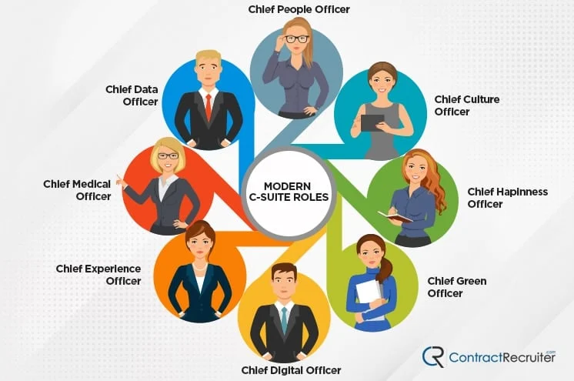
Chief Data Officer in the Modern C-Suite
https://www.contractrecruiter.com/list-csuite-roles-titles/
Notes:
So the question is, why is this role so important, and how has the role evolved to adapt to the need within organizations
Enterprises are realizing that new leadership is needed to take on the responsibility for data and information value
CDO has arisen to fill this need. Making the CDO a new role within the C-suite
Traditionally the C-suite consists of roles including: Chief Executive Officer (CEO), Chief Operating Officer (COO), Chief Financial Officer (CFO), Chief Revenue Officer (CRO), etc.
Additional Modern C-suite roles that have cropped up in recent years can be seen in the figure, for example: Chief People Officer, Chief Culture Officer, Chief Happiness Officer, Chief Green Officer, Chief Digital Officer, Chief Experience Officer, Chief Medical Officer and the Chief Data Officer to name a few.
The CDO has taken on a number of forms across different organizations, many organizations have experimented with the role.
Part of the realisation that the CDO is an important role, is made by senior executives in their understanding that data is now at the soul of enterprises.
Data plays a role in the never ending cycle of pursuing business value. And despite companies previously throwing large amounts of money, attention, and resources at different data initiatives, there was a lack of real value in the results obtained.
Data itself is now a C-level responsibility.
The Chief Data Officer is increasingly the C-suite’s solution to navigating today’s disruptive, dynamic, data-intensive world. It’s a bespoke role that must be tailored to the needs and culture of the business. At the same time, the CDO is responsible for enabling the organization with a core set of capabilities engineered to sense and respond to changing demands.

Slide 5


Problems occurring before the rise of the CDO
Lack of insights or value from data
Lack of responsibility for the data
Data seen as an inconvenient means to an end
Data issues getting in the way of productivity
IT being expected to manage, fix, remediate, and make data consumable
Notes:
Some of the main problems that arose before the Chief Data Officer role was introduced was to do with the poor management and performance of data
Part of the problem with the lack of insights or value taken from data, lies with the perception of who is responsible for leveraging data in business processes
Data has previously been labelled as an inconvenient means to an end – merely a mechanism to get work done. Data issues were slowing businesses down and getting in the way.
These issues are something that IT organizations were seemingly supposed to manage, fix, remediate, and make consumable.
IT was not up to this task. The perception that IT should be solely responsible for data is changing.
Digital transformation of the enterprise changes this perspective, for the first time businesses were having to look at end-to-end processes and the entire customer lifecycle to effectively respond to customer needs.
IT were not capable nor expected to be responsible for the change in business values or fundamentals as this would be a decision that would require an executive mandate. Data is now considered the most valuable asset of organizations.

Slide 6
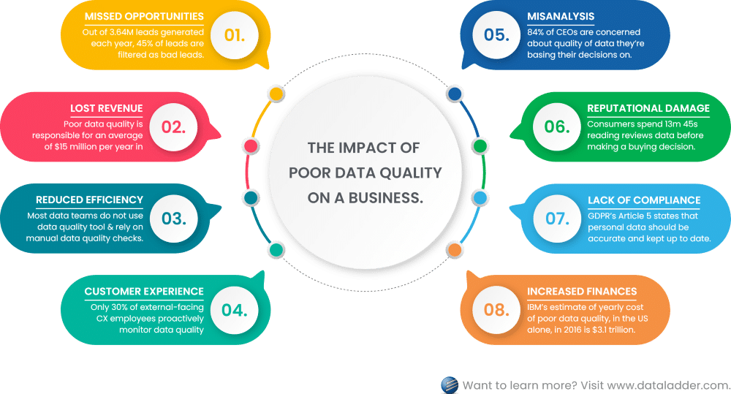
https://dataladder.com/the-impact-of-poor-data-quality-risks-challenges-and-solutions/
Notes:
A lot of data challenges within organizations are still the traditional ones, such as data management, and making sure you do data onboarding in a quality and efficient fashion.
Analytics strategies will not succeed if there is a lack of quality data to begin with.
Example of some of the impacts of poor data quality on a business include: Missed opportunities, lost revenue, reduced efficiency, customer experience, misanalysis, reputational damage, lack of compliance and increased finances.
When data issues are not addressed at the source, downstream users will try to fix them.
This is problematic because the downstream users are usually high-cost analysts, actuaries, or data scientists;
when these users fix the data, they create a new source that others in the organization might not know about or be able to access;
when others cannot access the “fixed” data, they might use different assumptions or approaches that will make it difficult to reconcile the resulting multiple copies of the data.
https://dataladder.com/the-impact-of-poor-data-quality-risks-challenges-and-solutions/

Slide 7
The role of a CDO
Create
Create a culture or proactive stewardship
Get
Get the opinions and input of users, line-of-business managers, and leadership
Eliminate
Eliminate the acts of heroics
Establish
Establish data ownership
Remediate
Remediate upstream processes
Resolve
Resolve conflicts
Change
Change the way systems and processes produce and consume data
Have
Have a cross-functional and cross-business-unit understanding
Notes:
CDOs have their work cut out for them
CDOs need to be able to create a culture or proactive stewardship, get the opinions and input of users, line-of-business managers, and leadership
They are expected to eliminate the “acts of heroics” that many organizations rely on to get products to market, campaigns launched, and programs successfully completed. Focus is made on removing the guess work from tasks as this is not a scalable solution
In addition they need to establish data ownership, remediate upstream processes, resolve conflicts, and change the way systems and processes produce and consume data.
Finally, they need to have a cross-functional and cross-business-unit understanding of how information flows through the enterprise and know how to measure efficiency, quality, and effectiveness.
Traditional responsibility was with the CIO and within the ‘business units’ that were producing and consuming data. The focus had been on serving customers and employees rather than looking at data holistically.
Enterprise capabilities and agility around data are needed to compete with born-digital and other disruptive market entrants.
Being able to rapidly create new products and offerings depends on being able to quickly and cost-effectively assemble the correct data from various internal and external sources, and then craft that data into a user experience that provides value or solves a specific problem. Rapid experimentation and evolution are part of the faster clock speeds that every industry is experiencing
CDOs work in different functional areas with managers who are trying to achieve business objectives, such as greater market penetration and increased profitability.
They help those managers to understand how the quality of data impacts their business objectives.
Many corporate goals fail to be achieved because top-level support is lacking. The CEO must be an on board with the message that data quality is the first step in the information ecosystem. This message starts with the CDO, who can connect abstract concepts to tangible business outcomes. The CDO understands that the process starts with the onboarding of data—whether internal or external.
For example, customer and marketplace data goes through an ecosystem of processes and applications and eventually becomes part of a marketing strategy. Data quality issues will cause that marketing strategy to fail, however, because poor quality data leads to faulty baseline assumptions.
------------------------------------------
What they do:
• Lead the data and analytics agenda of an organization
• Establish and deliver technologies, tools, approaches and methodologies to unlock the value in enterprise data assets of an organization
• Manage data as a strategic asset and operationalize data governance, data quality and other controls to sustain the integrity of the data of an organization
• Serve as trusted partner to key business executives focused on the customer, enterprise risk management, regulatory compliance and finance
• Fosters innovation leveraging emerging Big Data and analytics technologies

Slide 8
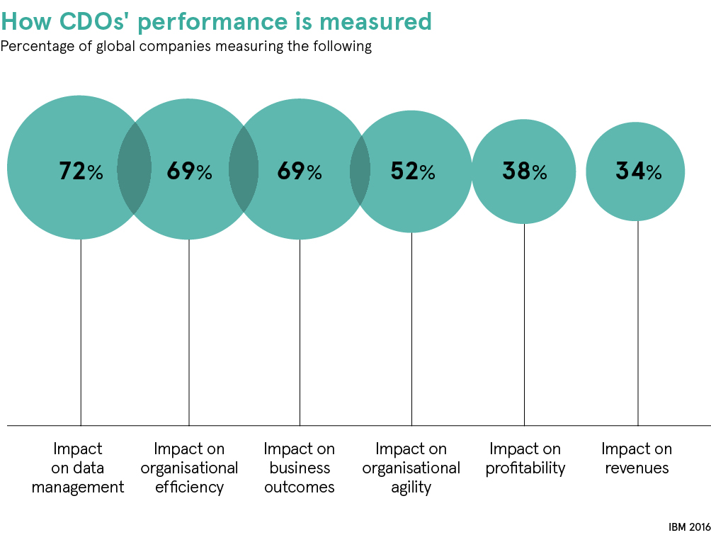
Benefits of having a CDO
Increase visibility and awareness in the C-suite
Focus on cultural change
Focus on process change
Focus on data quality issues
Focus on governance
https://www.raconteur.net/c-suite/successful-cdo/
Notes:
What benefit will the CDO have within organizations and why is this role needed?
When an organization is establishing a new role, several questions need to be answered: What will be different? How will having a CDO change how the business operates? How will it impact decision making processes, policies, and the technologies that are used to run the business day to day?
The CDO needs to be an empowered position with the support of the rest of the leadership team. The CDO can change the status quo in several ways
Some of these benefits include:
• Increase visibility and awareness in the C-suite. The CDO will have the ability to communicate and collaborate with leadership. CDOs can raise the visibility of process issues and focus attention on innovation with data that the CIO does not have bandwidth for or awareness of.
• Focus on cultural change. Many CDOs spend their time educating executives about the importance of data and what can be done to innovate with data assets. This effort could be directed toward producing a specific outcome, or toward increasing awareness of cross-functional challenges and processes that impact the ability to leverage data most effectively.
• Focus on process change. Some CDOs roll up their sleeves and work with managers at the level of specific initiatives and programs that are geared toward a new capability or specific outcome.
• Focus on data quality issues. Data quality in a particular domain— for example, customer data— requires significant effort to address due to the number of stakeholders, processes, systems, and applications that are impacted. Many times, these are part of master data initiatives, which can take years to implement, so this should be seen as a long-term responsibility.
• Focus on governance. Data and information governance is a thread that runs through all of these areas and a CDO could stand up a governance program to tackle all of these challenges. Some CDOs do not get directly involved in governance, acting more as ambassadors and liaisons rather than taking on this operational aspect of the role. Lack of effective governance (which includes data strategy, data quality, and data ownership) is a significant impediment to digital transformations.
A CDO’s performance can be measured in many different ways. For example in the figure, a percentage of companies measure the CDO’s performance usings the following measures:
Impact on data management, Impact on organisational efficiency, impact on business outcomes, impact on organisational agility, impact on profitability and impact on revenues.

Slide 9
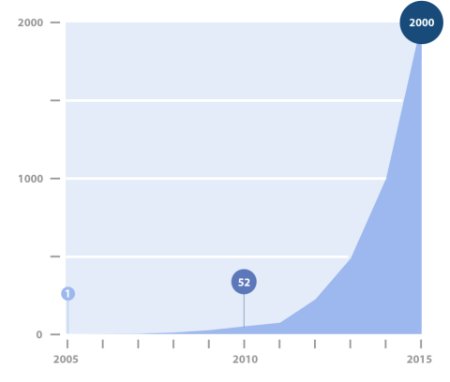
Increasing popularity in the Role
First coined in 2001 when Joe Bugajski was appointed VP and Chief Data Officer at Visa International.
Only two others held the title through 2005. Gartner Group estimated in November of 2016 that 2000 people now hold the title.
https://info.earley.com/hubfs/Slide-Decks/EIS_ERT-Evolving-Role_CDO-2017-02.pdf
Notes:
The Role of the Chief Data Officer has increased in popularity since its introduction in 2001. The term itself was first coined when Joe Bugajski was appointed VP and Chief Data Officer at Visa International. He was employed as the Chief Data Officer for 7 years at Visa International.
He then went on to other companies such as Gartner where he established the role of the Chief Data Officer worldwide within the organisation.
Only two others held the title through 2005, with the Gartner Group estimating in November of 2016 that 2000 people held the role.
From the graph we can see that the growth was exponential within the role from 2005 to 2015.
Now in 2023, when I use the CDO search term on Linkedin search to get an estimate of numbers within the position, I was able to find 48,000 people with CDO in their title or profiles.
https://info.earley.com/hubfs/Slide-Decks/EIS_ERT-Evolving-Role_CDO-2017-02.pdf

Slide 10
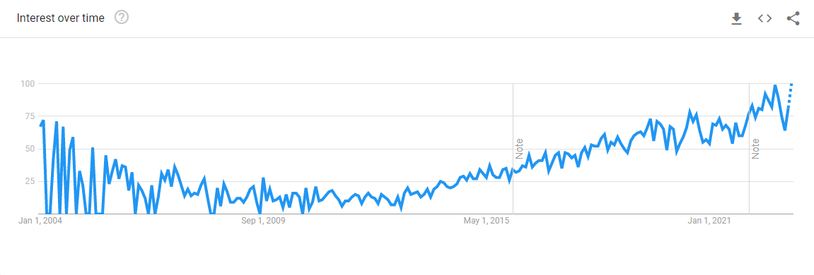
Google Trend ‘Chief Data Officer’ Interest Over Time
https://trends.google.com/trends/explore?date=all&q=%2Fm%2F07k3s_
Notes:
I carried out a search on Google trends to see the popularity of the topic ‘Chief Data Officer’ on google web search worldwide from 2004 to present. The search engine data goes as far back as 2004 which works for this analysis because the term was first coined officially in 2004.
There is initial interest that can be seen from the figure when the term was first introduced, interest in the topic began fluctuating after September 2005. From September 2011, there was an steady increase in the popularity in the Chief Data Officer as a search term.
Numbers on the graph represent search interest relative to the highest point on the chart for the given region and time. A value of 100 is the peak popularity for the term. A value of 50 means that the term is half as popular. A score of 0 means there was not enough data for this term.
The Chief Data Officer search term reached 99, the highest it has been, in September 2022

Slide 11
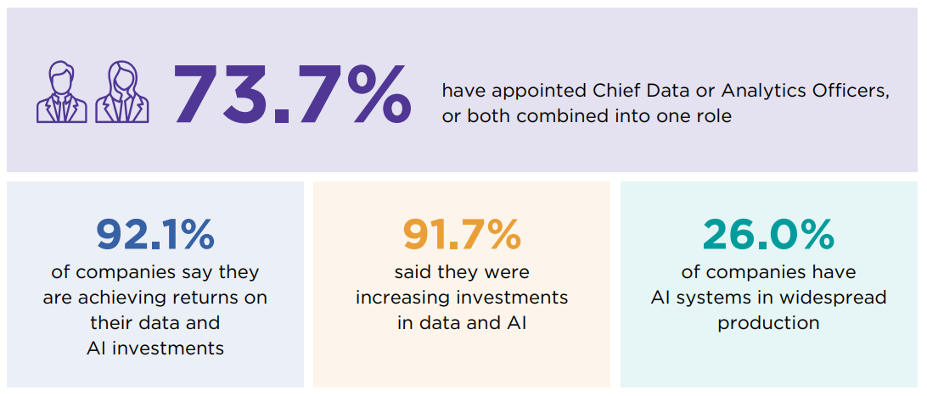
CDO from organization to organization
https://www.newvantage.com/_files/ugd/e5361a_ad5a8b3da8254a71807d2dccdb0844be.pdf
Notes:
The CDO Role Varies by Organization.
Different types of CDOs are needed for different types of industries and maturity levels. For an organization early in the learning and maturity curve, the job is more about education and awareness, than getting involved in day-to-day issues. Others set up an infrastructure of decision-making bodies and rules and then move on, while others continue to lead those decision making groups on an ongoing basis.
Depending on the maturity of the organization and the demands of its industry’s state of transformation, as well as the state of its infrastructure (some transformations require major technology upgrades, such as costly enterprise resource planning replacements), the organization will need very different types of CDOs and CDO agendas. However, the core responsibility for data, data quality, and achieving greater business value from that data is common to all the manifestations of the CDO role. The average tenure of CDO’s is just two to two-and-a-half years
The following figures are taken from the ‘DATA AND AI LEADERSHIP EXECUTIVE SURVEY 2022’
Almost three quarters of the 94 firms (73.7%) have appointed Chief Data or Analytics Officers, or both combined into one role.
That’s a huge increase since the 12.0 % reported in 2012
The role is considered “successful and established” by 40.2% of the firms participating in the survey, which is up by about 7.0% for each of the last two years.
92.1% of companies say they are achieving returns on their data and AI investments, which is up markedly from 48.1% in 2017.
91.7% said they were increasing investments in data and AI, equalling last year’s percentage.
26.0% of companies have AI systems in widespread production—more than double the 12.1% last year.
To simply, data and AI initiatives are becoming well-established, investments are paying off, and companies are getting more economic value from AI. These are all significant accomplishments.

Slide 12

Typical Salaries for this role
United States average salary is $219,290 as of January 2023
Ireland average salary is €170,000
Notes:
The average Chief Data Officer salary in the United States is $219,290 as of January 26, 2023, but the range typically falls between $192,190 and $263,890.
Salary ranges can vary widely depending on many important factors, including education, certifications, additional skills, the number of years you have spent in your profession.
https://www.salary.com/research/salary/alternate/chief-data-officer-salary
Chief Data Officer Salaries in Ireland €170,000 /yr
https://www.glassdoor.ie/Salaries/chief-data-officer-salary-SRCH_KO0,18.htm

Slide 13
Key Takeaways
The role is still relatively new
The role of CDO is still in its early stages
The role is likely to remain fluid for a number of years
How the role is expressed depends on the company’s maturity level
The role of CDO will be pivotal to ensure the agility needed for future growth and success
CDO is a role that can provide significant value to the enterprise
Notes:
The role is still relatively new.
The role of CDO is still in its early stages
The role is likely to remain fluid for a number of years.
How the role is expressed depends on the company’s maturity level with respect to data management, as well as other factors such as size and industry sector.
It is important to align with and delineate clear responsibilities among related roles such as CIO and CTO.
The role of CDO will be pivotal to ensure the agility needed for future growth and success.
CDO is a role that can provide significant value to the enterprise. Given today’s data-driven environment, this role is likely to be on a growth trajectory for some time

Slide 14

Questions?

